Slide 1
【WebSphere Developer for zSeries】
Project Creation and Configuration

Slide 2
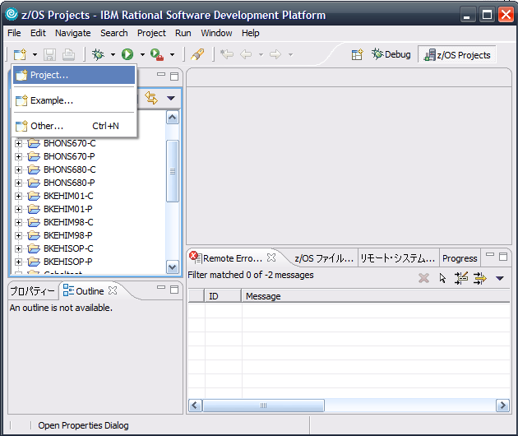
1. Create a new project
Create a new project

Slide 3
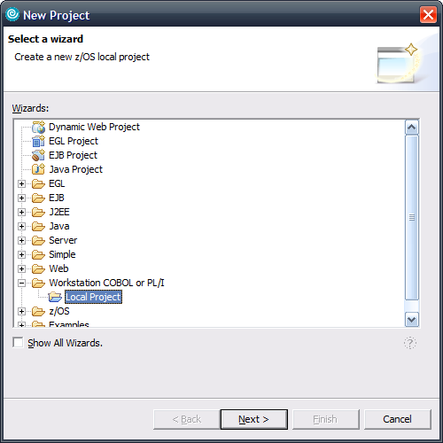
2. Create a Cobol or PL/I project

Slide 4
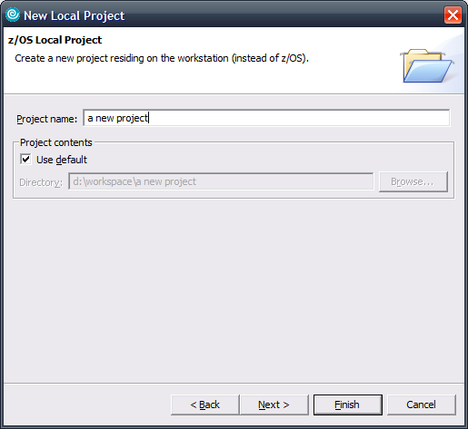
3. Specify the name of the project

Slide 5
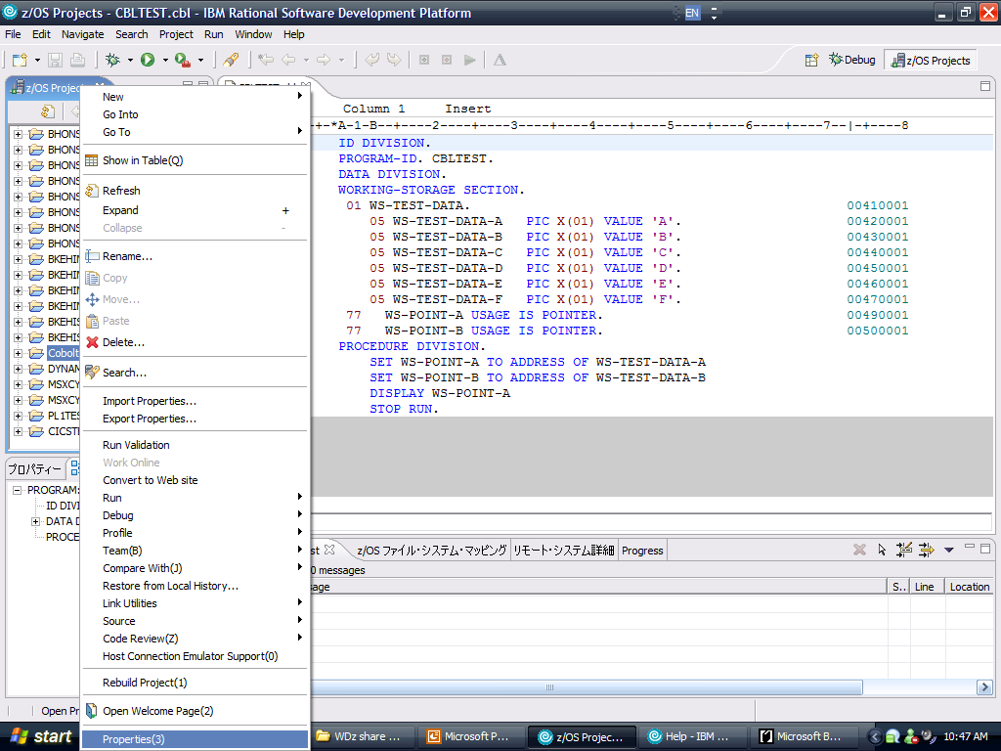
4. Specify the properties of the project

Slide 6
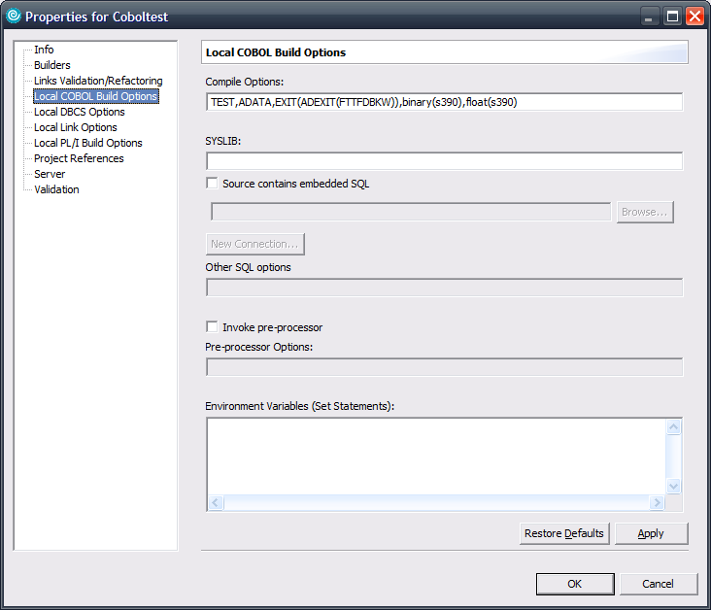
5. Specify the parameters of Cobol project
For Cobol project, specify ‘Local COBOL Build Options’
For PL/I project, this step is unnecessary
Use below parameters to simulate OS390:
TEST,ADATA,EXIT(ADEXIT(FTTFDBKW)),BINARY(S390),FLOAT(S390)
BINARY(S390): BINARY, COMP, COMP-4 FLOAT(S390):COMP-1, COMP-2
Specify the location of your copybook
Suffix name should be .CPY
If DBCS needed in program, add ‘set DBCS on’

Slide 7
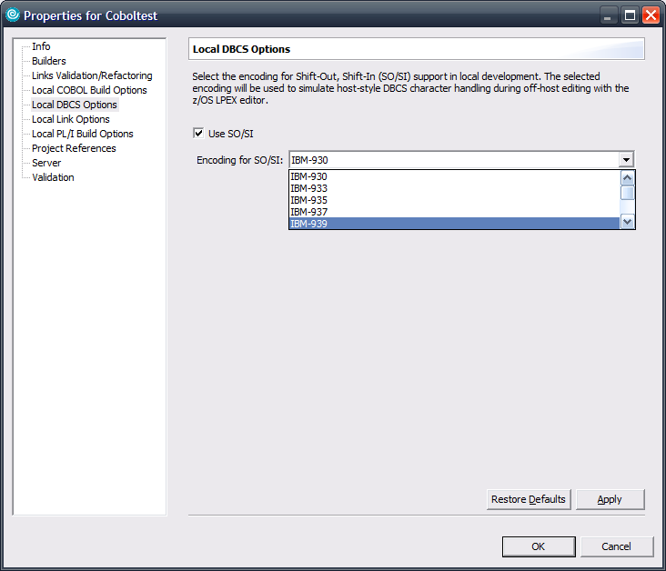
6. Simulate SO/SI
If DBCS needed in program, select ‘IBM-939’ to show SO/SI in program.

Slide 8
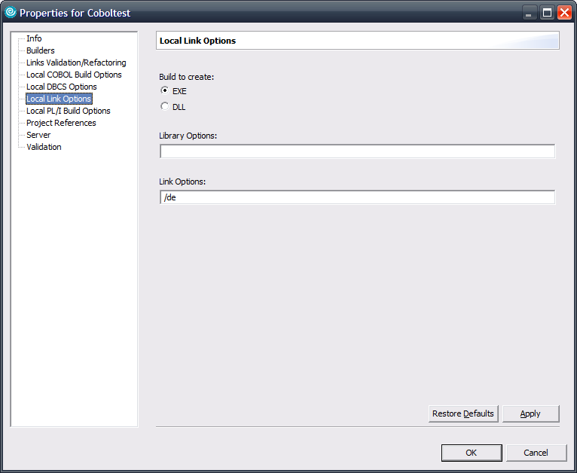
7. Specify build module type
For Cobol:
Main program should be builtout as EXE.
Subroutines which will be called by dynamic mode, should be builtout as DLL.
For PL/I:
all programs should be builtout as EXE

Slide 9
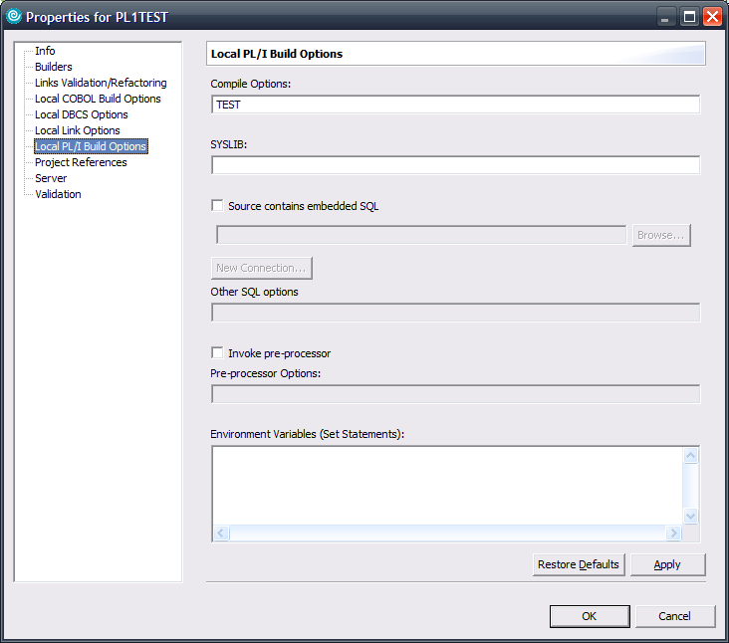
8. Specify the parameters of PL/I project
For PL/I project, specify ‘Local PL/I Build Options’
For Cobol project, this step is unnecessary
Specify the location of your copybook
Suffix name should be .INC
If DBCS needed in program, add ‘set DBCS on’

